Slide 1

COMPANY PROFILE
EMED
BIOMEDICALSS

Slide 2


WELCOME TO OUR COMPANY
We, EMED BIOMEDICALS, are a medical equipment service provider with 21 years of experience in the healthcare industry, giving us the expertise to support any kind of medical equipment requirement.
Our key areas of focus include:
1) Project Handling.
2) Medical Gas Pipeline Systems.
3) Modular Operation Theatres.
4) Clean Rooms.
5) Equipment Planning & Procurement.
6) Biomedical Consultation.
7) Equipment Sales.
8) Equipment AMC and CMC.
9) Equipment Service and Repair.
10) Biomedical Accessories Supply.

Slide 3

VISION & MISSION
Vision
To Bridge healthcare and technology with expert solutions.
Mission
To provide our Customer Prompt and Best Support as and when required to minimize the Breakdowns & Downtime, to educate, to develop, to keep the Customer, Problem free.

Slide 4

Our Ongoing Projects
1
2
3
Arunavisalakshi eye care Hospital
Uthiramerur Government Hospital
Santhoshi Hospital
Puzhal, Chennai
Uthiramerur
Mannivakkam, Chennai

Slide 5



Our Recent Projects
Supreme Specialty hospital
Raphael lifecare Hospital
01
02
Padur, Chennai
Uthramerur, Chennai
IMED Specialty Hospital
Aynavaram Trust hospital
03
04
Pondicherry
Aynavaram, Chennai

Slide 6




Supreme Specialty hospital
01

Slide 7
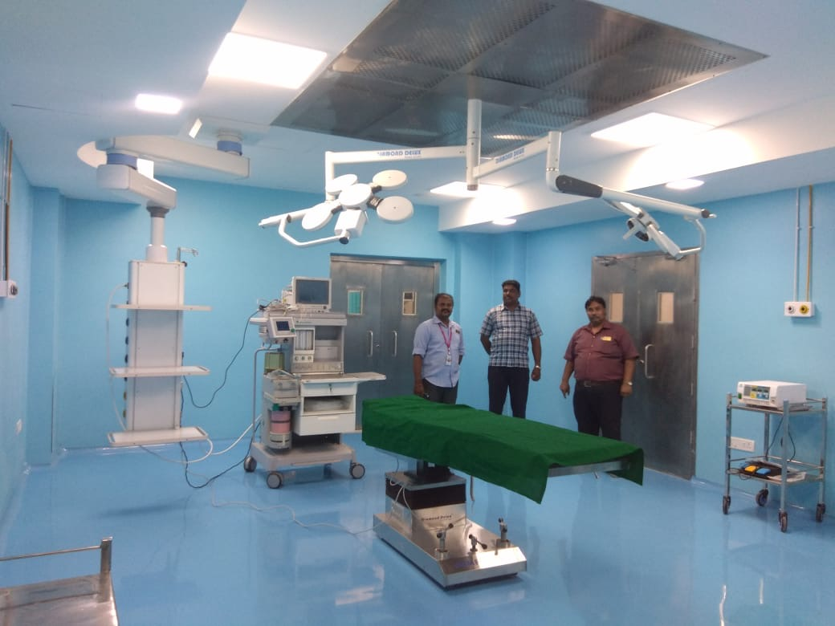


Slide 8
Raphael lifecare Hospital
02

Slide 9
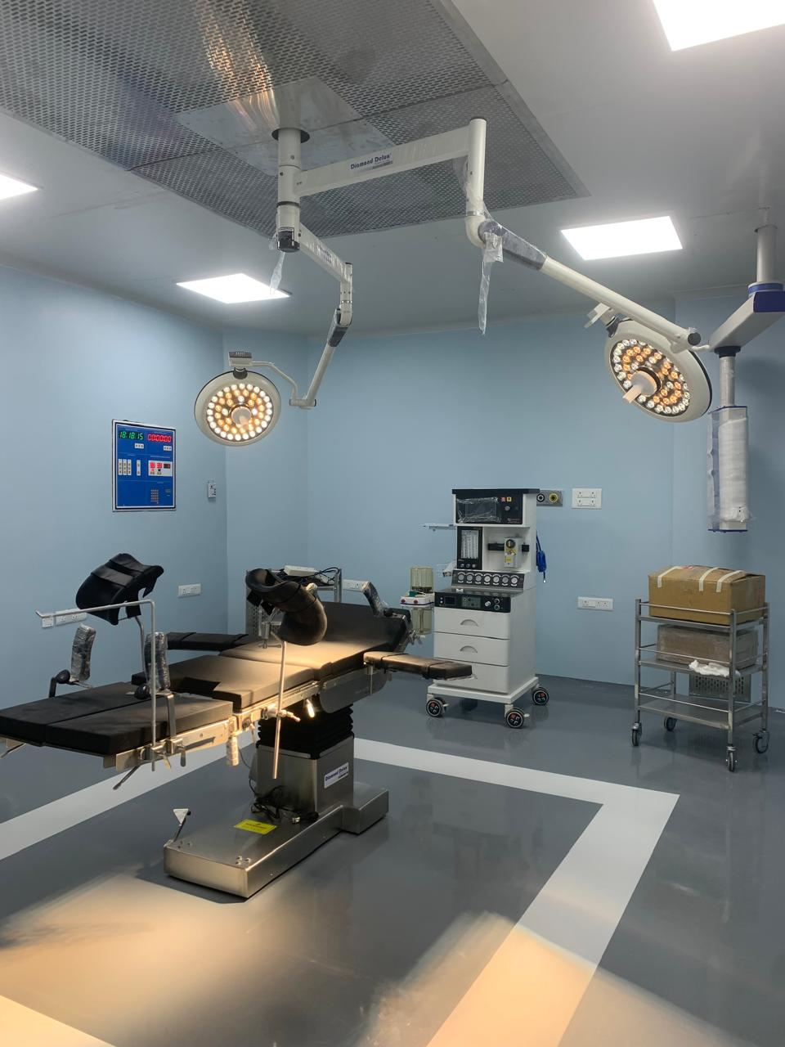
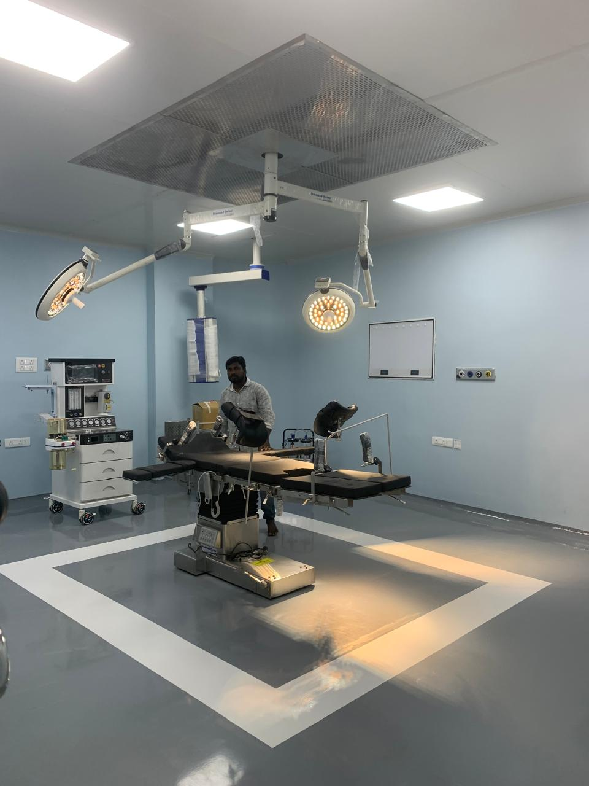

Slide 10
IMED Specialty Hospital
03

Slide 11
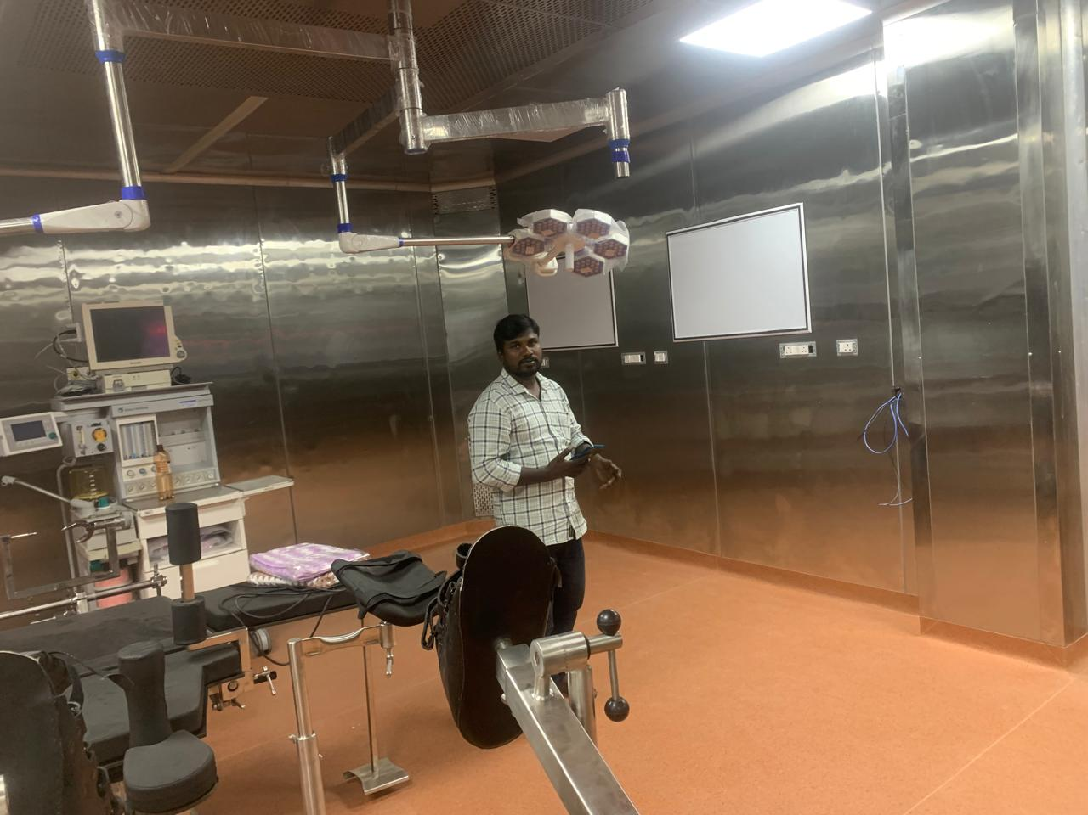

Slide 12
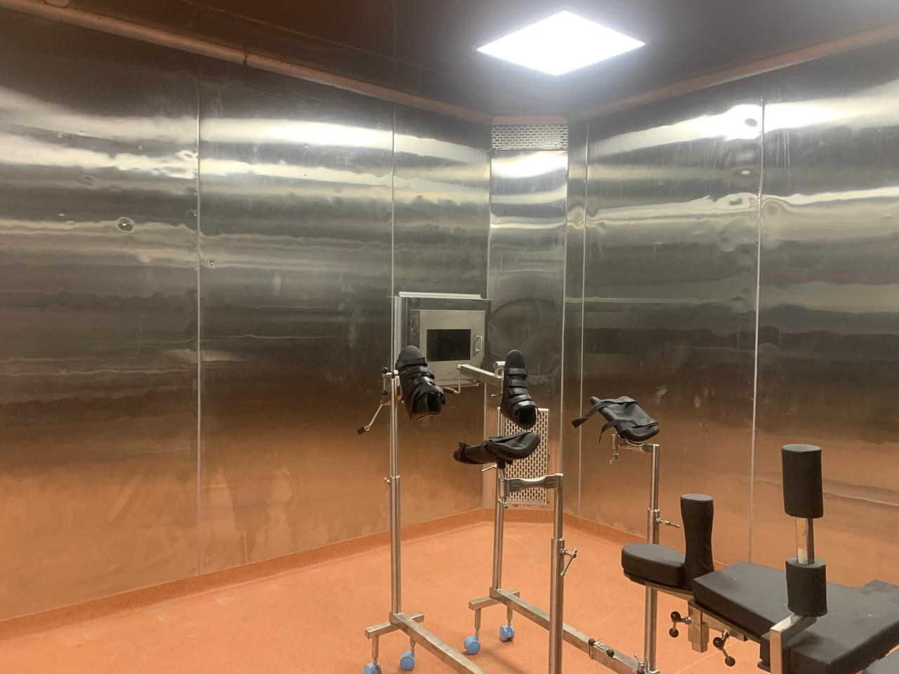
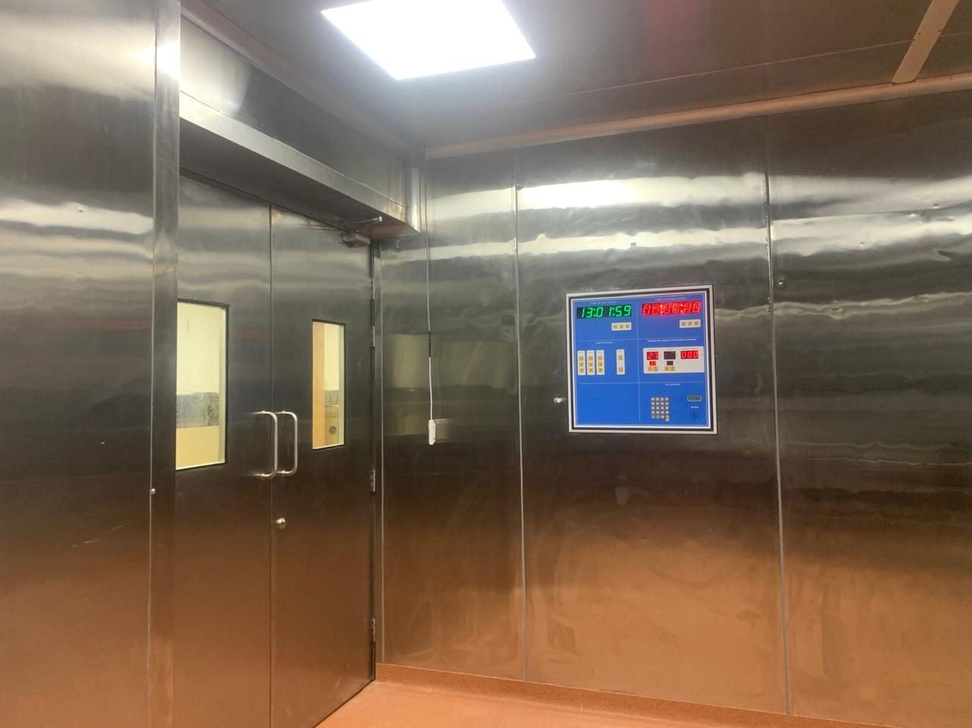

Slide 13
Aynavaram Trust hospital
04

Slide 14
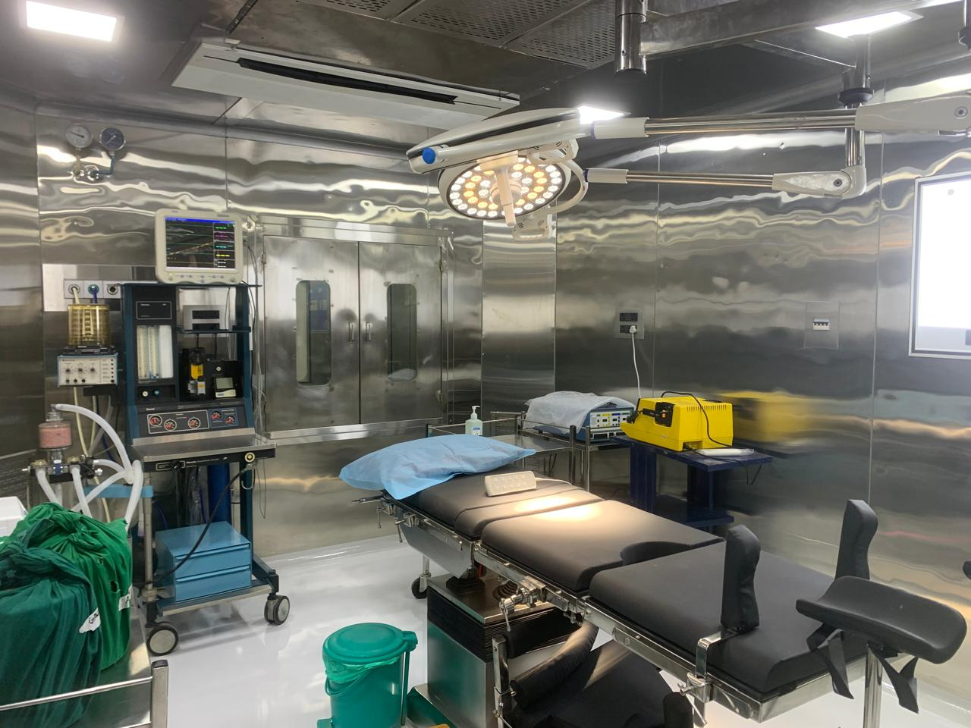
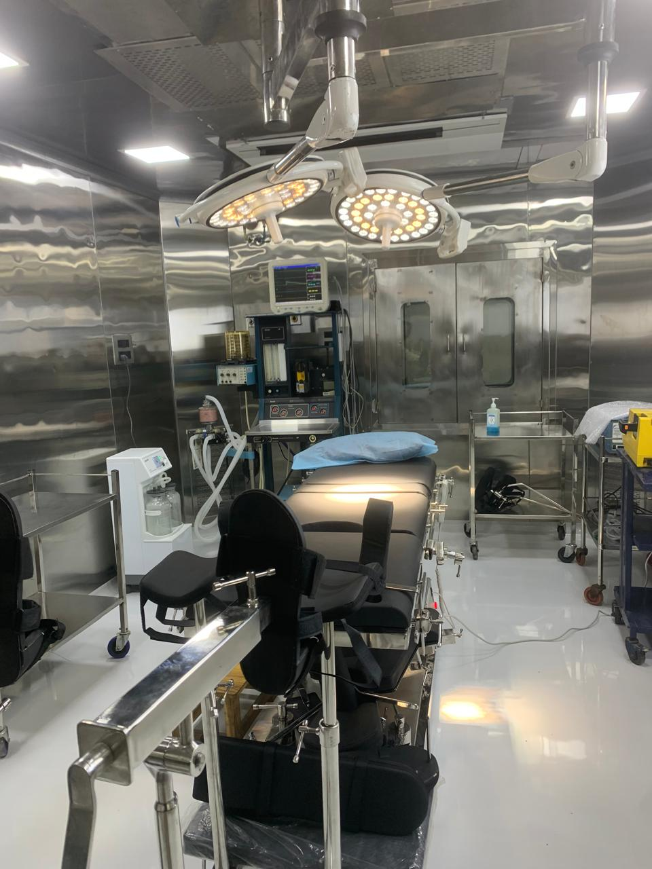

Slide 15
Equipment Sales!
OT EQUIPMENT
RADIOLOGY EQUIPMENT
CRITICAL CARE EQUIPMENT
DIAMOND DELUXE
HSIL
ADONIS
HSIL
PIXXGEN
HSIL

Slide 16














SOME OF OUR CLIENTS
01

Slide 17

Experience
Why Choose Us?
21Years in the field of Medical Excellence
Own Manufacturing
We manufacture AHU, Laminar flow, and Panels, ensuring the highest quality at the right price.
Planning and Support
Well-organized, timely, and planned working manner as committed. We provide long-term post-installation service support.

Slide 18





CONTACT US
We look forward to working with you
Phone : +91 97907 59552
Website : www.emedbss.com
Email : emedbss@gmail.com
Address : 100C VOC Str, Injambakkam, Chennai

Slide 19
THANK YOU
WWW.EMEDBSS.COM

